Slide 1

CorrelationKC
Team: Gauntlet

Slide 2
Objective
Tech Stack
Screenshots
References
Work Done

Slide 3
Work Done
Data has divided into Train(80%), Test(20%)
Data is classified into Numerical, categorical
Filtered Data based on correlation values >0.3 and <-0.3
No Null values found in data, so we didn’t use mean, median or mode to fill the NULL values
Implemented Prediction on:
Black Persons In Poverty
Households With Income Less Than $10,000
Minority

Slide 4
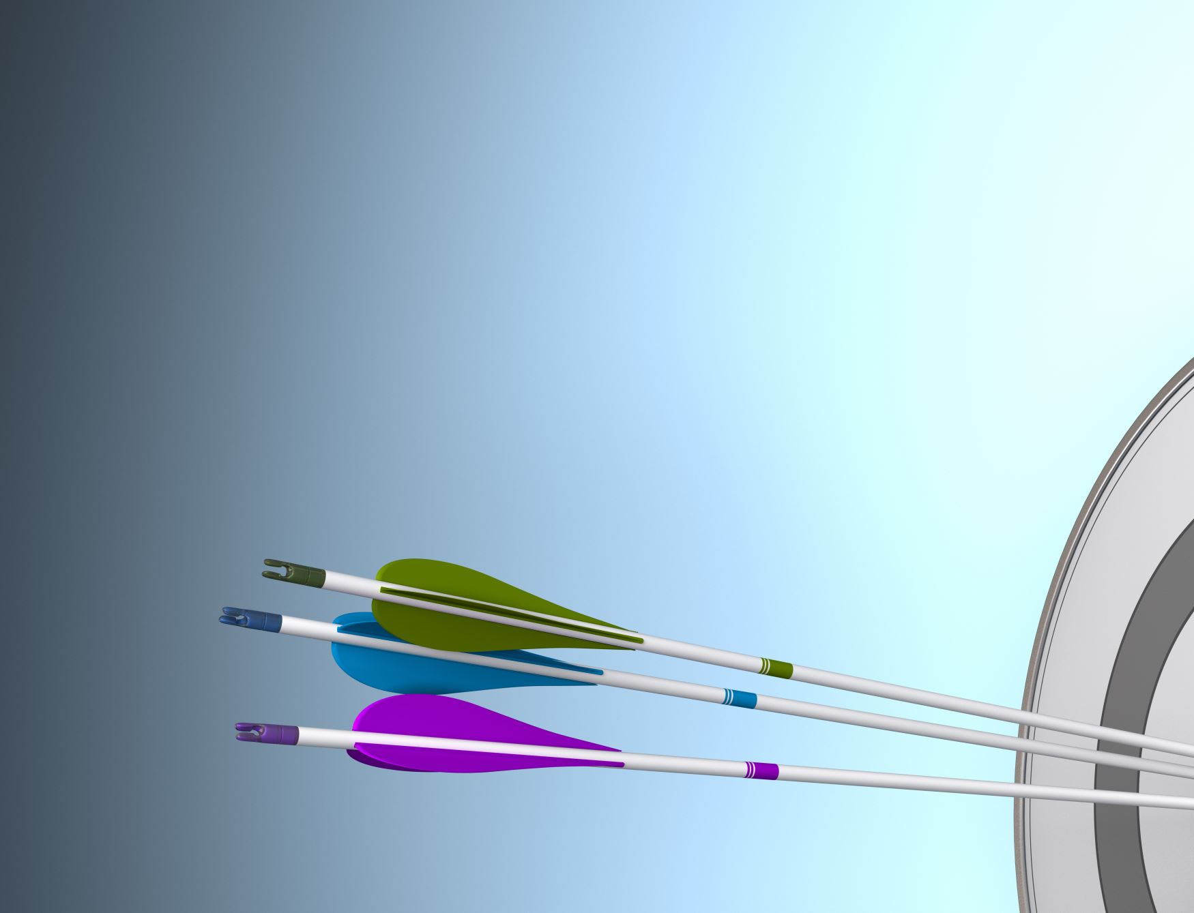
Tech Stack
We have used :
Corr()-correlation
LabelEncoder
le.fit_transform
LinearRegression
train_test_split
DecisionTreeRegressor
RandomForestRegressor
GradientBoostingRegressor
accuracy_score
r2_score

Slide 5
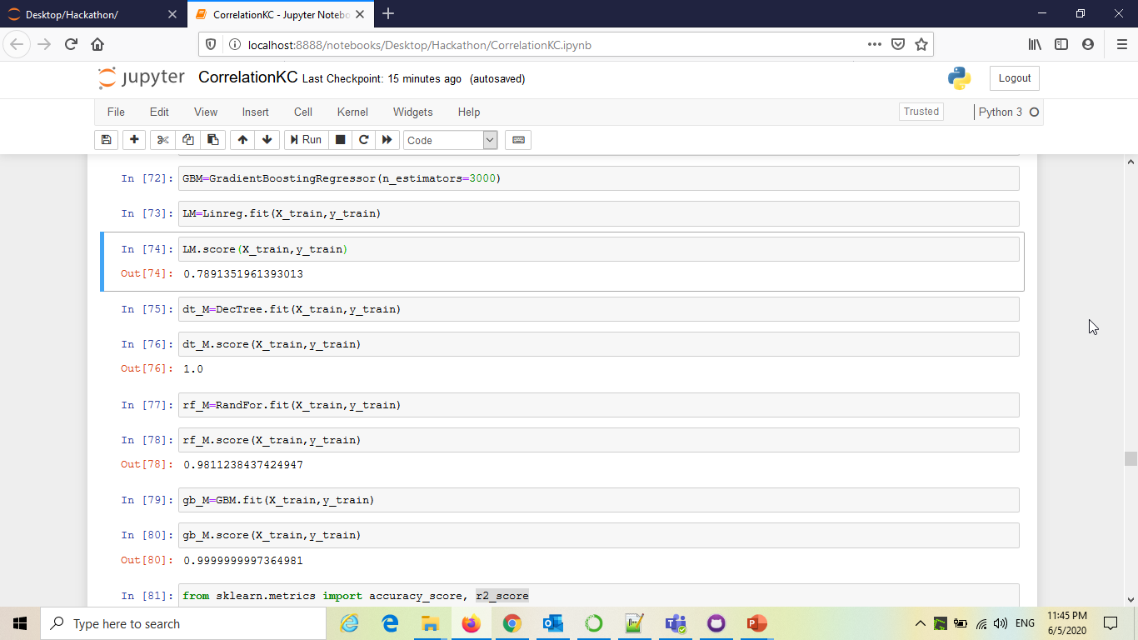
Screenshots

Slide 6
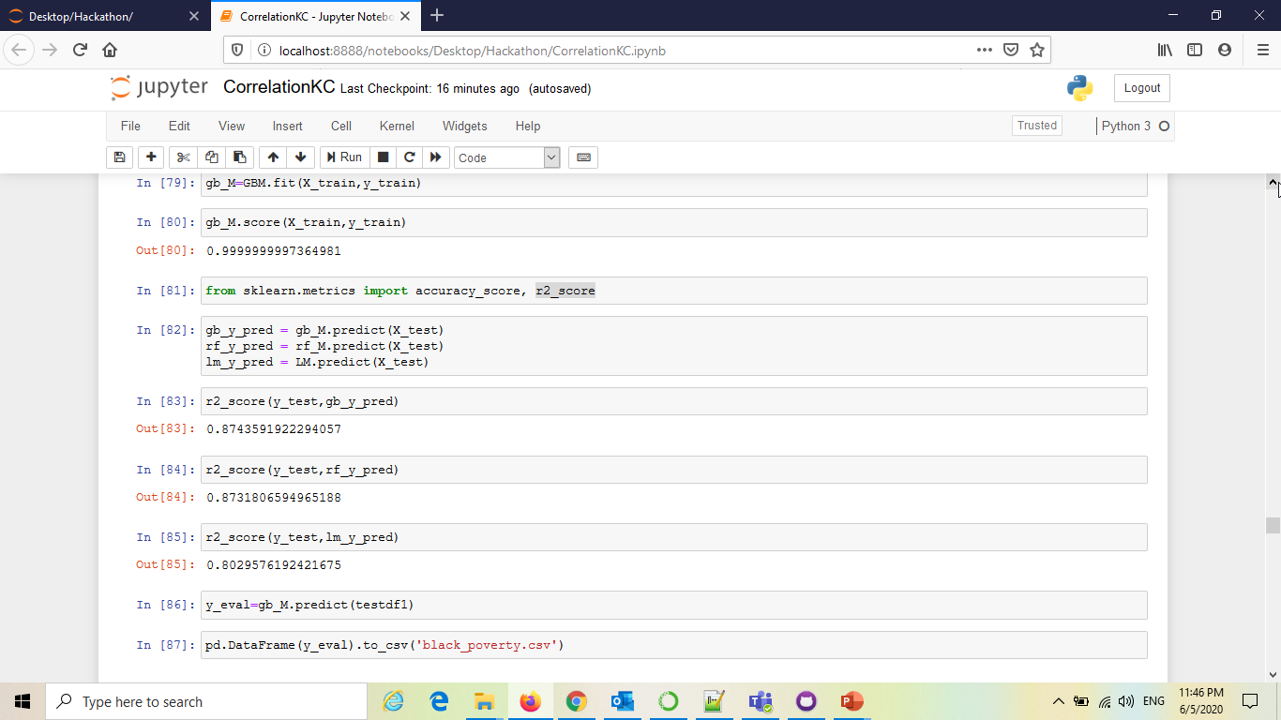

Slide 7
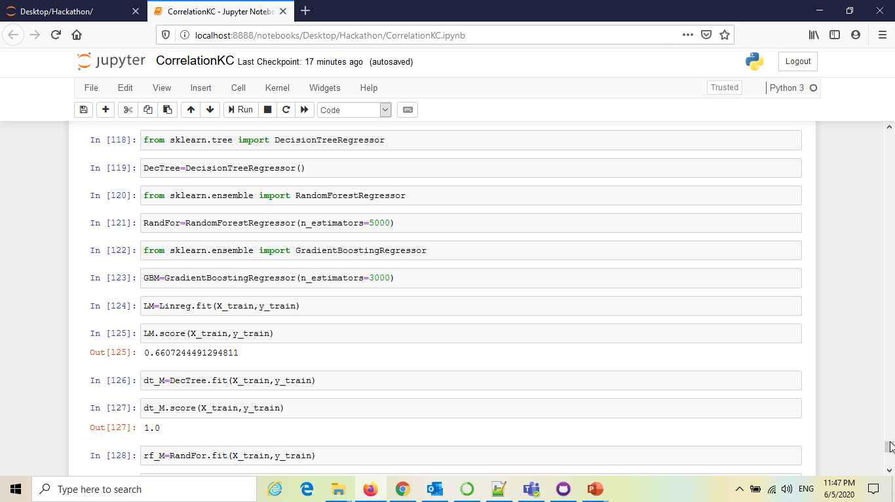

Slide 8
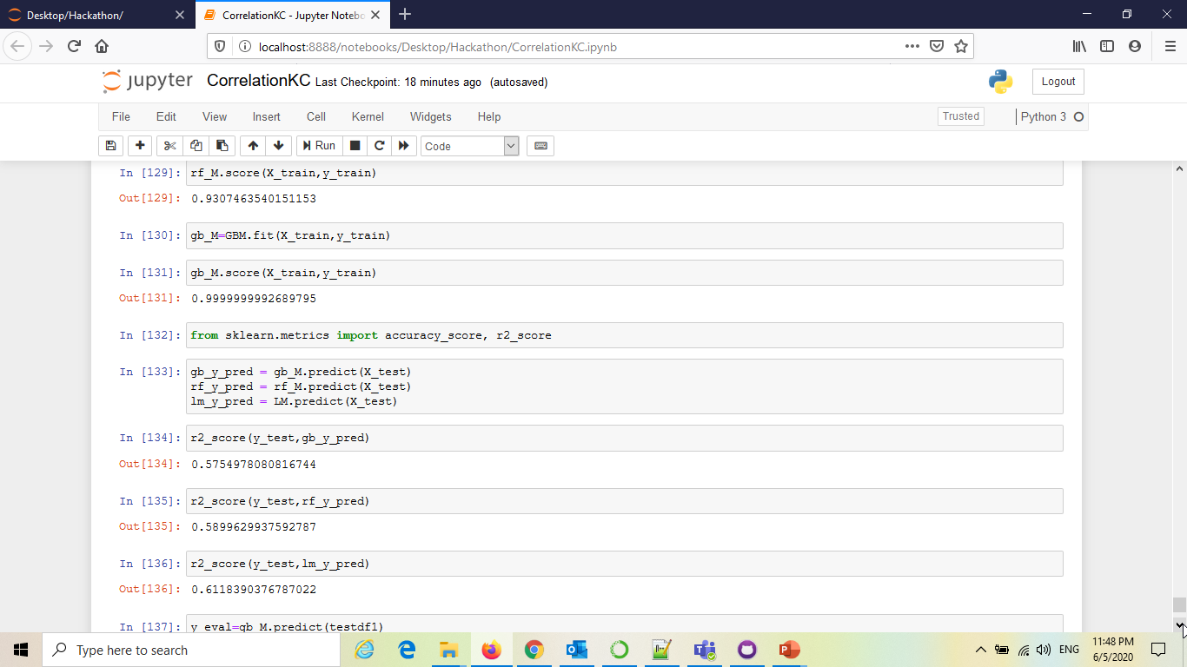

Slide 9
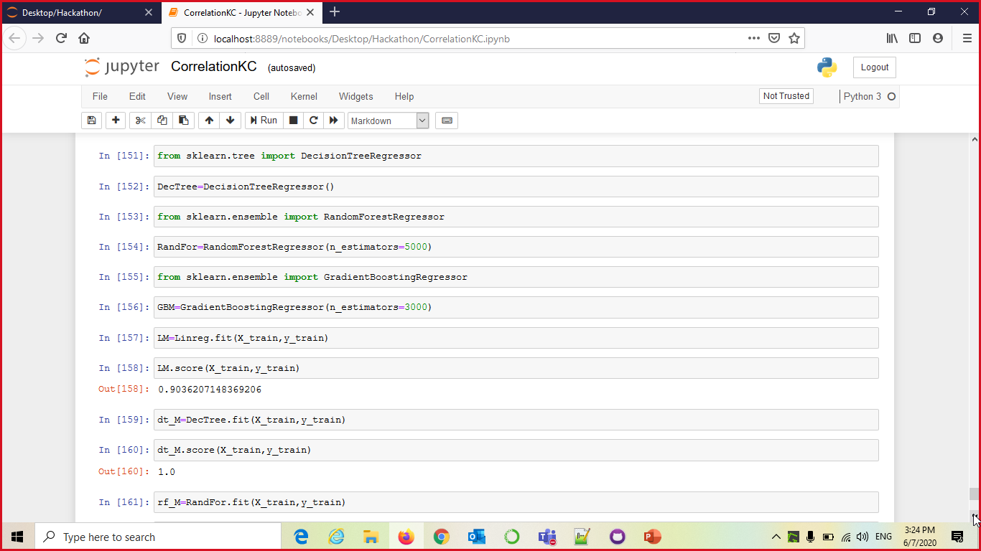

Slide 10
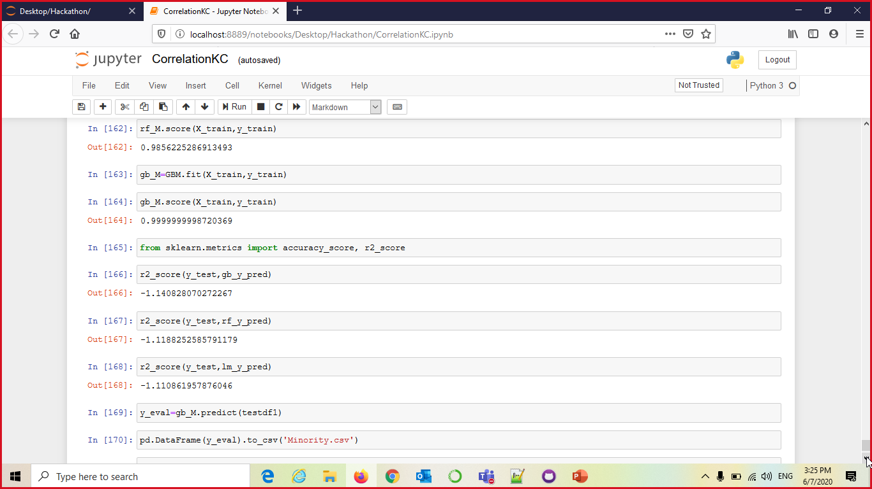

Slide 11
References
https://www.w3schools.com/python/python_ml_train_test.asp
https://scikit-learn.org/stable/auto_examples/svm/plot_svm_regression.html#sphx-glr-auto-examples-svm-plot-svm-regression-py
https://scikit-learn.org/stable/modules/generated/sklearn.preprocessing.LabelEncoder.html
https://scikit-learn.org/stable/modules/generated/sklearn.svm.SVC.html

Slide 12

Thank You…

